Slide 1
Presented by
Md. Robel Mia 152-15-5538
Sabuj Sarker 152-15-5703
Puja Saha 152-15-5792
Dipto Saha 152-15-5867

Slide 2
Our Project Title Healthcare monitoring system

Slide 3
Objective
Online based
User friendly
Reduce time & money
Easy to access
Admin monitor total system
Payment also online based
Doctor scheduling management
Modern website integrated

Slide 4
Background Analysis
In other healthcare system it can support the patient information only but can’t support the patient appointment.
Some system can support patient appointment only
or Doctor scheduling only
or Medicine supplier only
But our system one in all
In normal system for book appointment user need to go the hospital
But in our system user can give appointment by staying their bed room since our system is online based.

Slide 5
Proposal
Our main target is to made a platform where any user or patient give any kind of service “one in all” such as……
Patient get information with SMS
From our system user give up the hospital list
User don’t have to waste their time for appointment
Nurse manage report and assist doctors
Laboratory's attach diagnosis report

Slide 6
At a glance of our Project

Slide 7
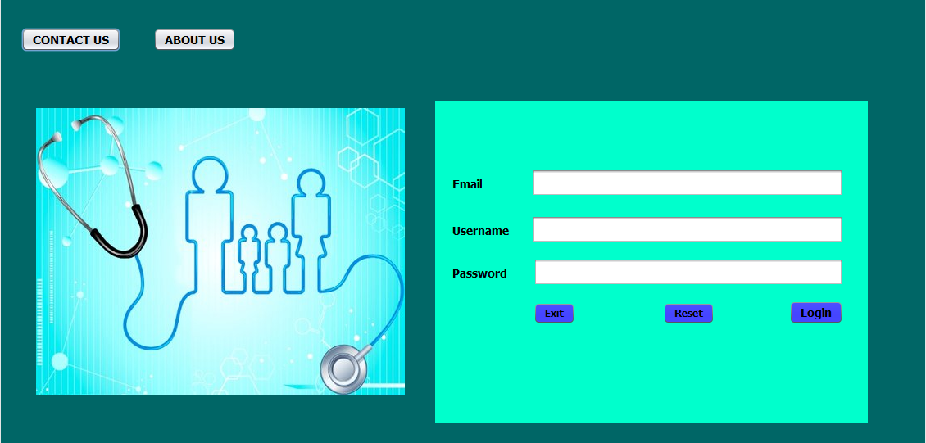
Login Page

Slide 8
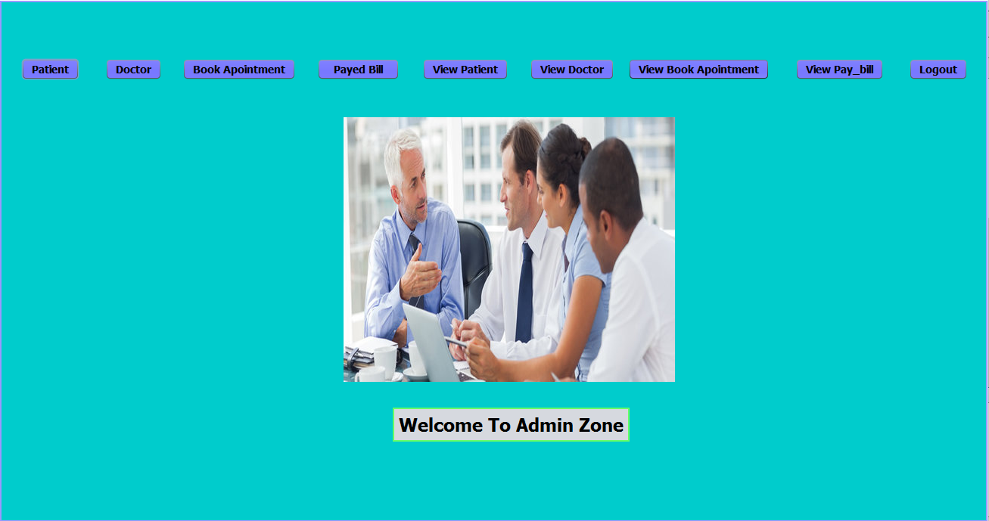
Admin Panel

Slide 9
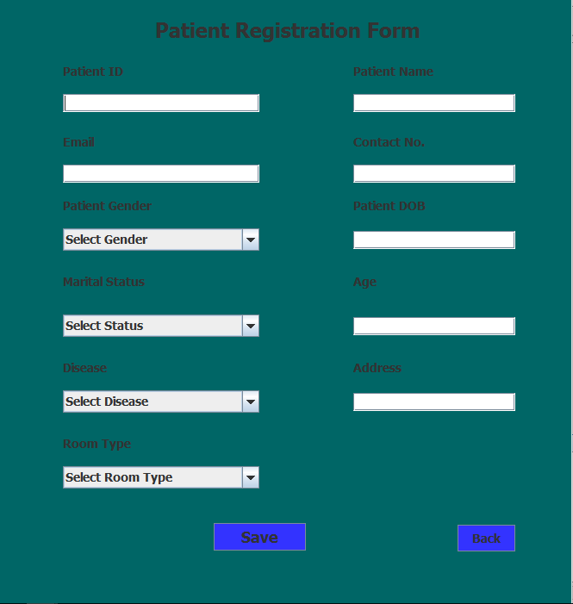
Patient Registration Form

Slide 10
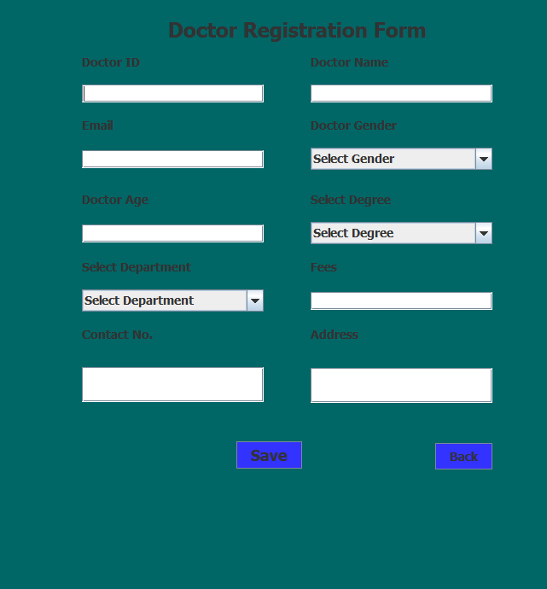
Doctor Registration Form

Slide 11
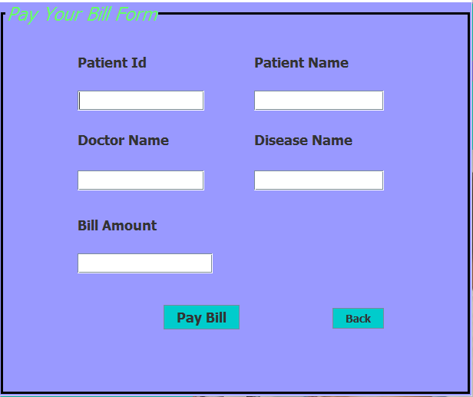
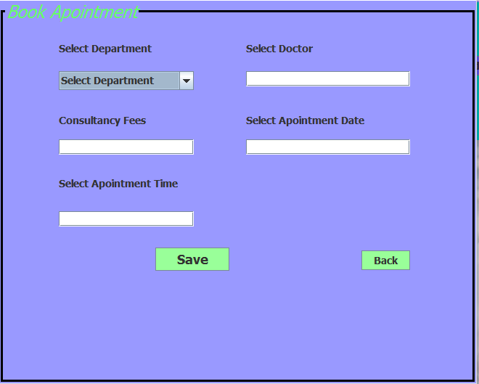
Book Appointment
Pay Bill Form

Slide 12

Doctor Panel

Slide 13
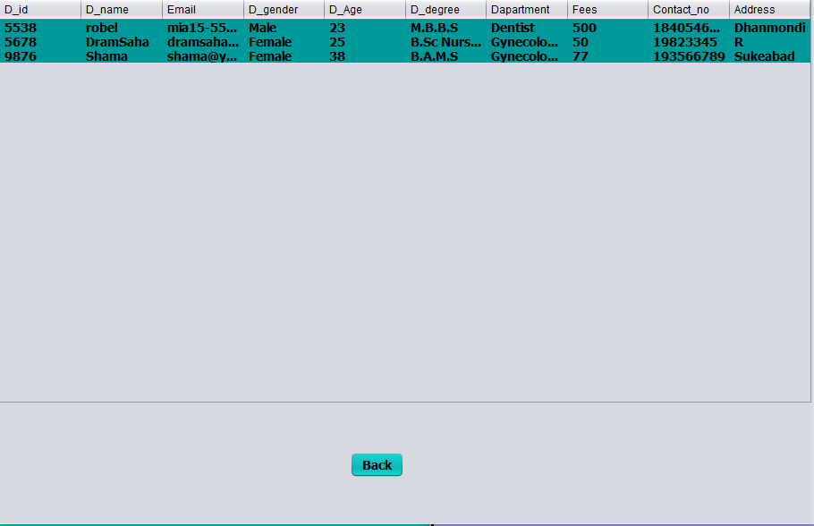
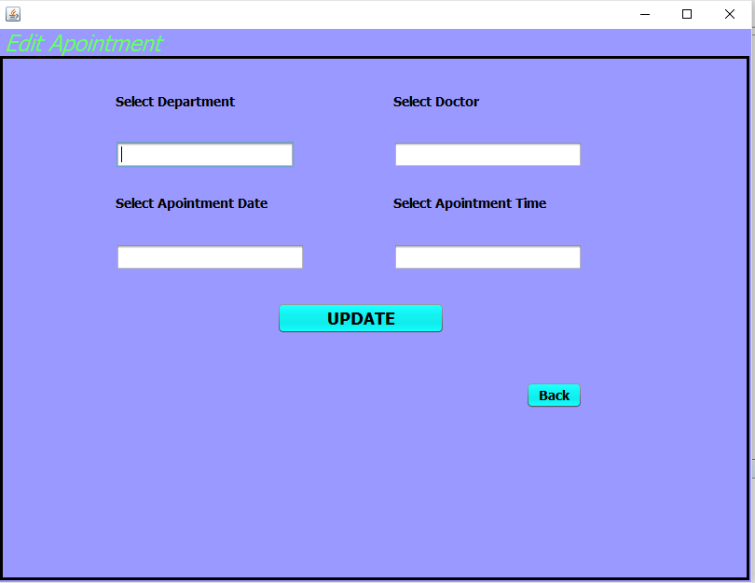
View Profile of Doctor
Edit Appointment

Slide 14
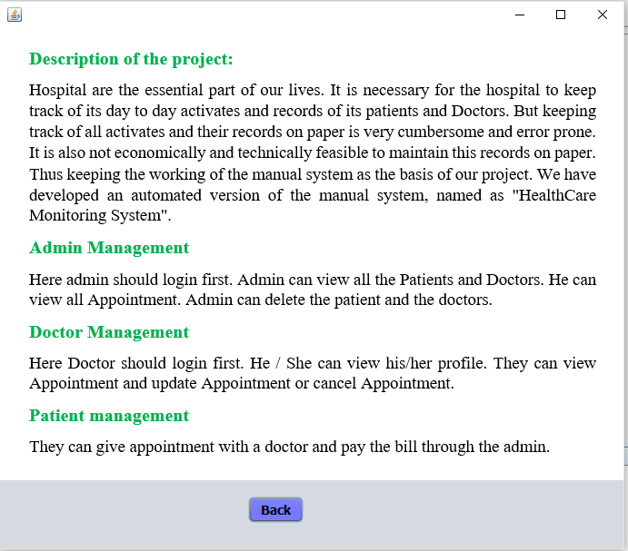
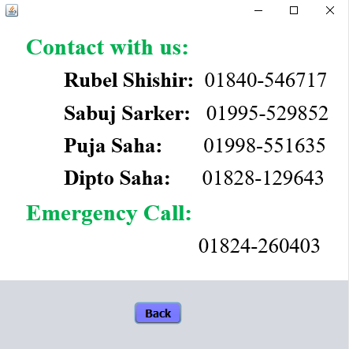
Contact Us
About Us

Slide 15


